Slide 1
Monitoring of anesthesia
Central nervous system
Cardiovascular system
Respiratory system
Musculoskeletal system
Hepatic, Renal and
Endocrine systems

Slide 2
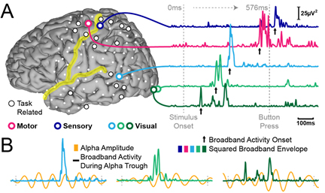
CNS monitoring
■ Anesthetic depth
■ EEG (Electroencephalography)
■ Response to stimulation
■ Reflexes
● Ocular
A-Palpebral
B-corneal

Slide 3
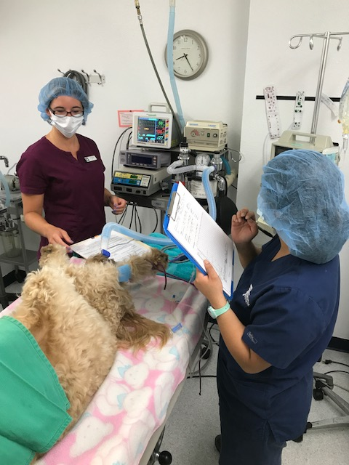
CNS monitoring
■ Eye position
■ Nystagmous
■ Muscle tone
■ Respiratory rate
■ Heart rate
■ Blood pressure

Slide 4
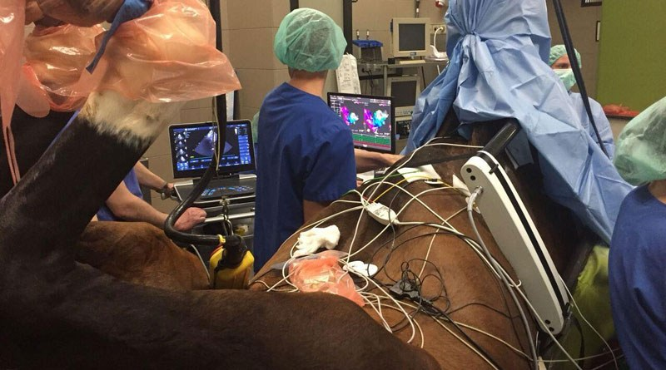
Cardiovascular system
■ Heart rate (bradycardia, tachycardia)
■ Electrocardiogram (ECG)
■ Cardiac output
■ Blood pressure

Slide 5
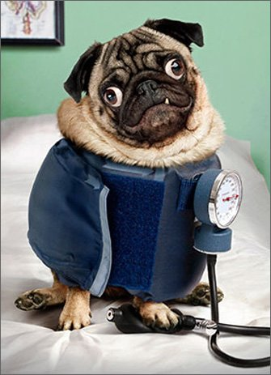
Monitoring HR and Rhythm
Digital palpation of pulse
Stethoscope
Electrocardiogram
Blood pressure monitor

